Slide 1


Risk Management For Neighborhood Associations
Ty Greaves, Executive Director
The UNSCC is a 501(c)3 corporation [77-0369577] founded in 1995 whose member neighborhood and homeowner's associations work to create, serve, and empower neighborhood association throughout Santa Clara County. Please visit our website at www.unscc.org.

Slide 2


What’s At Stake? Why Should I Care?
Your Can Lose Your Reputation and Money
There are Many Risks & Liabilities

Slide 3

What Are My Risks?
A Non-profit Or Group/Club Can Be Held Liable For Damages (Organizationally And, Rarely, Personally)
  Property Liability – Damage to the Physical Assets You Use Such As Buildings, Office Equipment, Computers, Furniture, etc. (i.e. Meeting Site Damage)
  General Liability - Negligent Acts Which Result In Bodily Injury, Property Damage, Personal Injury Or Advertising Injury To A Third Party (i.e. a Fall At An Event Or Meeting)
  Directors And Officers Lability - Wrongful Acts That Are “Intentional,” As Opposed To “Negligent” Events
  Improper Sexual Conduct And Physical Abuse Liability -Allegations Of Improper Sexual Contact (Community Activities)

Slide 4

Risks Are Unavoidable - So You Must Manage Them
To Fulfill Your Mission, You Must Incur Risks
  Fortunately, Neighborhood Associations Risks are Improbable
  Unfortunately, Liability is Hard to Predict and Price
Responsible Leadership Responses
  Risk Management – Identifies/Evaluates Risks, Particularly for Special Events, and Incorporates Risk Mitigation(s)
  Risk Mitigation - Process a Neighborhood Association undertakes to reduce its exposure to risks
  Risk Sharing - Insurance policy spreads the Liability Cost Across Similar Organizations

Slide 5
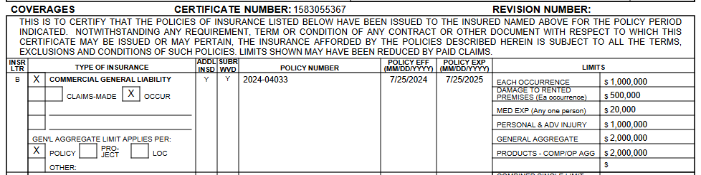
Let’s Get To It – Welcome To The UNSCC
As a Member Organization of the UNSCC Your Routine Meetings (General and Board) are Insured as part of Your Annual $200 Membership. This Protection is Conditional on:
  Apply for Insurance – Form Provided
  Acceptance by Underwriters
Extract of a Certificate of Insurance

Slide 6
What Else Is There?
Special Event Insurance for UNSCC Member Organizations for Your Parties, Cleanups, Neighborhood Nights Out, Field Trips, Jog-A-Thon, etc.
  Apply In Advance – At Least 25 Workdays
  If Coverage is Provided - Typical Cost is $126 for each Event – Can Be Higher for Activities that have Higher Risk
  Elements that Will Trigger Higher Cost (Typically $156), Underwriting Delays, or Refusals
    Bounce House – These are Popular but Generate Underwriting Issues. Special Guidelines and Requirements
    Homemade Food – UNSCC Recommends the Purchase of Commercially Prepared Food
    Power Tools – The UNSCC will Forward Your Request for Coverage, and it Will Cost More if Underwritten (Possible Refusal or Much Higher Cost)
    Serve Alcohol – Compliance with State and Local Laws/Regulations Typically Beyond a Neighborhood Association

Slide 7
Risk Mitigation – Plan Your Special Event To Minimize Risk
Example - Planning to Barbeque Burgers
  What will you do to ensure fresh ingredients?
    Purchase Commercial Food Items the Same Day and Store in an Ice Chest until Placed on the Grill.
  What Will You Do to Keep Kids from Burns?
    Cooking Area Will be Roped Off with Adults Controlling Access.
  What Will You do to Protect Attendees?
    Only Serve “Well Done" Burgers (145 degrees Internal Temperature or Higher)

Slide 8
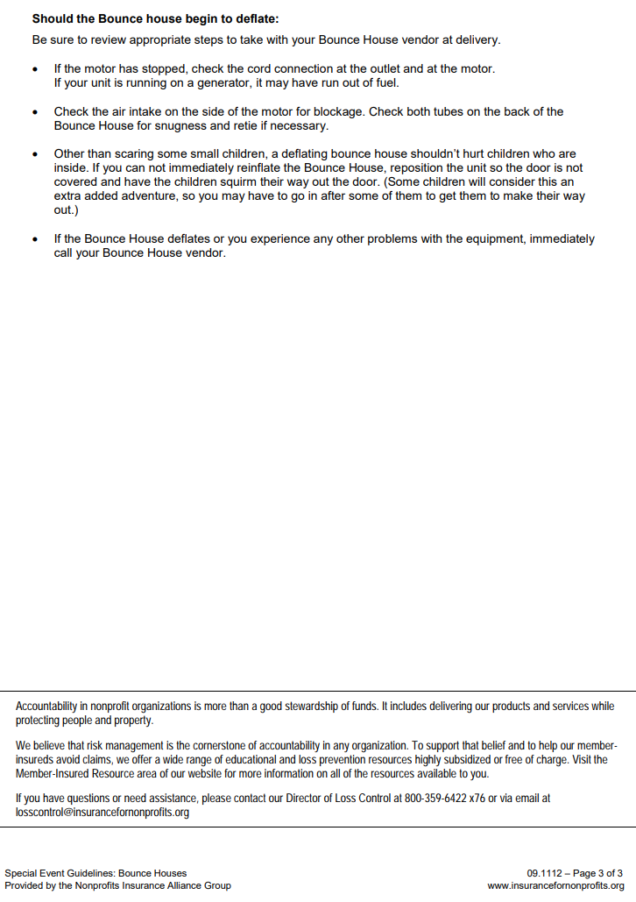
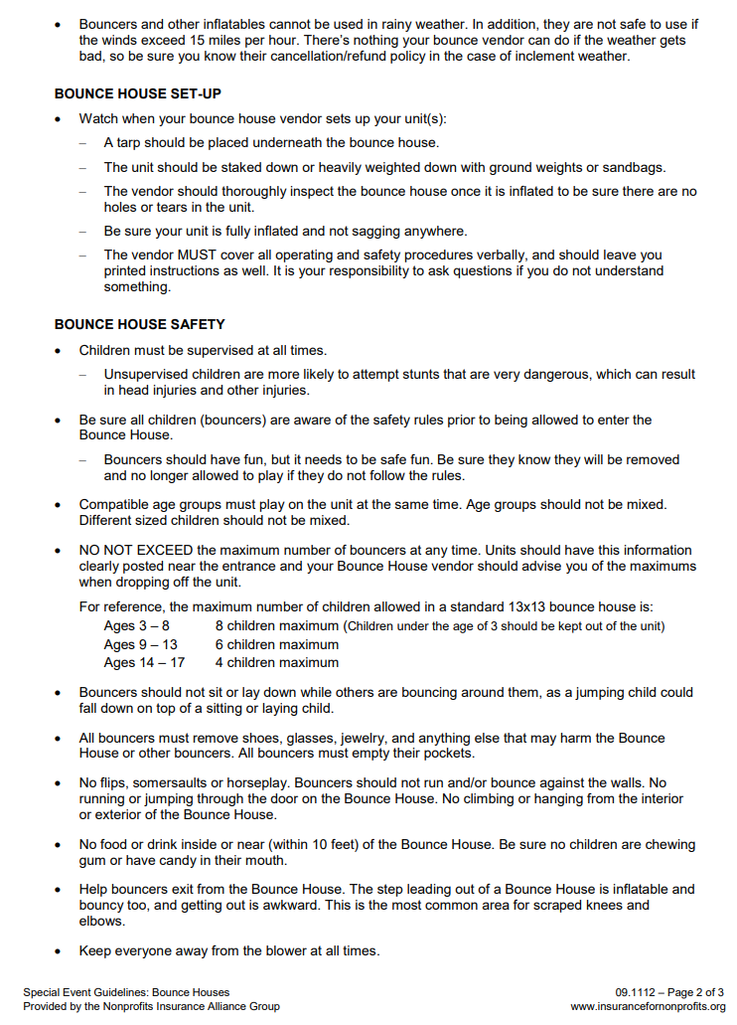
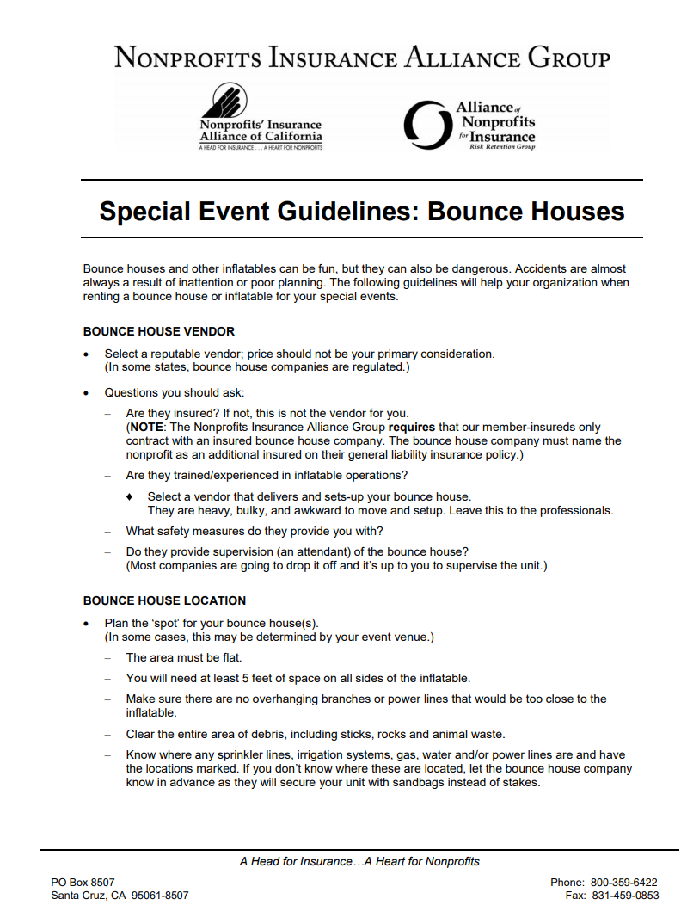
Let’s Talk About Bounce Houses – Fun But Risky
Nonprofits Insurance Alliance Group Requires
  Host Organization Must Contract with an Insured Bounce House Company
  The Bounce House company must name the UNSCC as an Additional Insured on Their General Liability insurance policy.
  Any Claim Will Exhaust the Bounce House Insurance Resources First – then NIAC Policy
Guidelines Provided

Slide 9
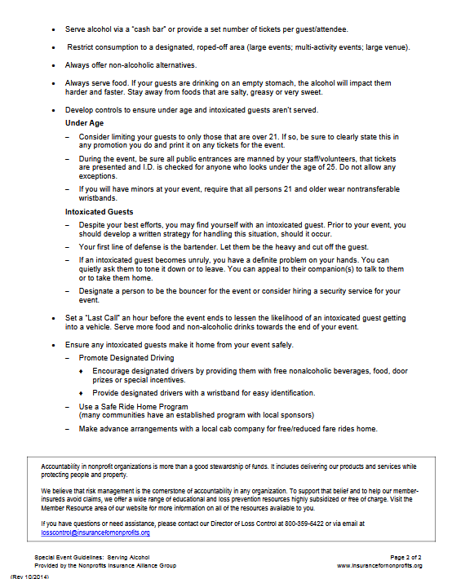
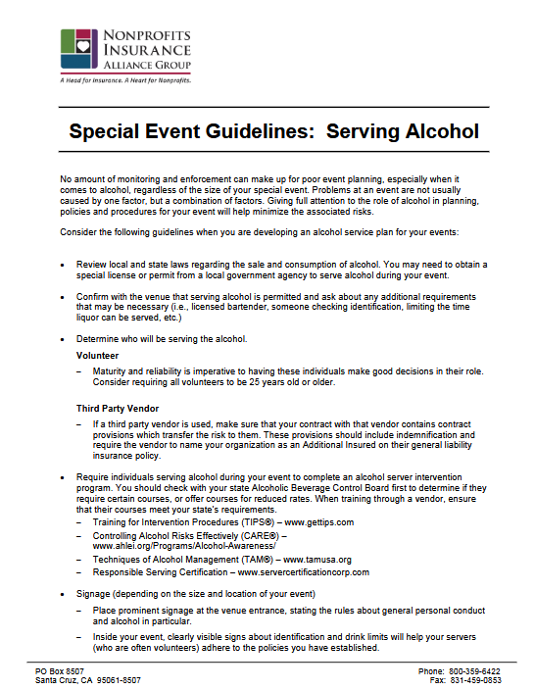
Let’s Talk About Booze – An Attendance Maximizer BUT
Nonprofits Insurance Alliance Group Requires
  Require individuals serving alcohol during your event to complete an alcohol server ABC Course(s)
  Clearly visible signs about identification and drink limits
  Develop controls to ensure under-age and intoxicated guests aren’t served.
  And Many MORE

Slide 10
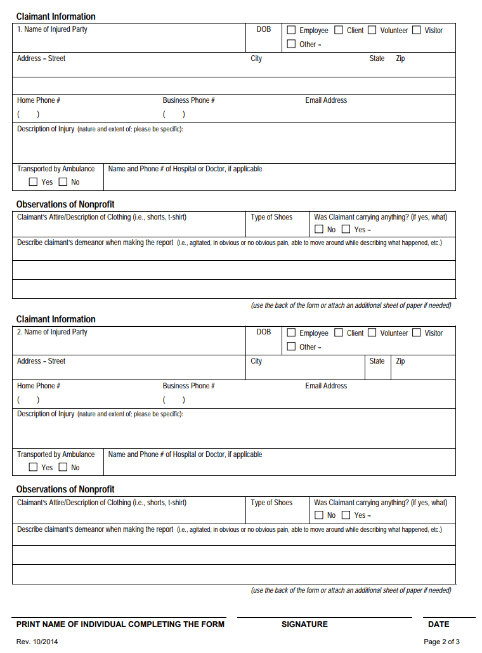
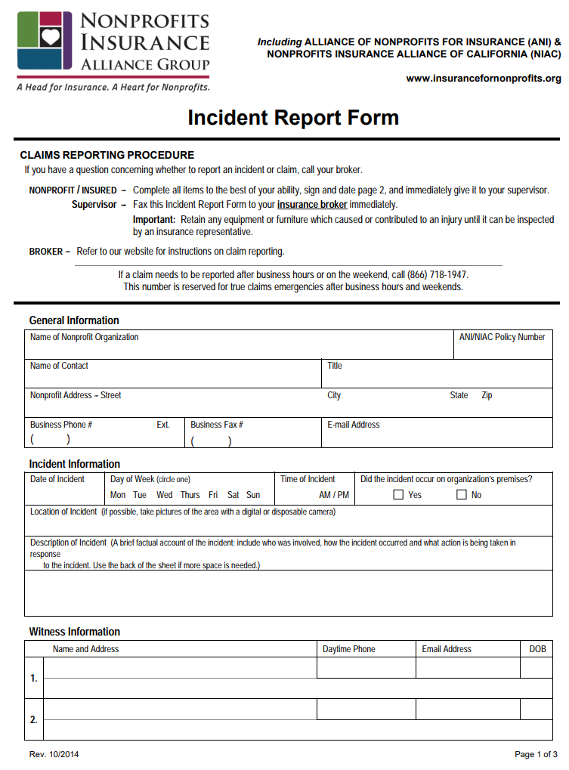
What To Do If There Is An Accident/Claim
Care for the Injured Person
Document Everything Using the Incident Report Form as a Guideline – Capture Photos
File Incident Report Form Immediately – Forms Provided
Call or Text the UNSCC 408-497-9261
Copy the UNSCC on All Correspondence.

Slide 11

NIAC Insures UNSCC Members
Non-Profit Insurance Alliance of California (NIAC)
Strong Relationship dating from 2007
$500 million in assets, NIA is a leader in the insurance marketplace for non-profits
Rated A VIII (Excellent) by AM Best
Governed by the Nonprofit Policy Holders
No Claim Ever Filed by the UNSCC or its Members
SOLID Risk Awareness, Identification, & Mitigation

Slide 12


Be Safe Out There

